Slide 1
Bank Management System
Submitted by:
S .Rishitha
Batch Code:2021-6139

Slide 2
Abstract :
In this section, we will learn how to create a mini-application for a banking system in Java.
In this program, we will add some basic functionalities of a bank account like a deposit of amount, withdrawal of amount, etc.
Initially, the program accepts the number of customers we need to add and adds the customer and account details accordingly.

Slide 3
Menu Display
Search by account number
Deposit the amount
Withdraw the amount
Display all account details
Exit

Slide 4
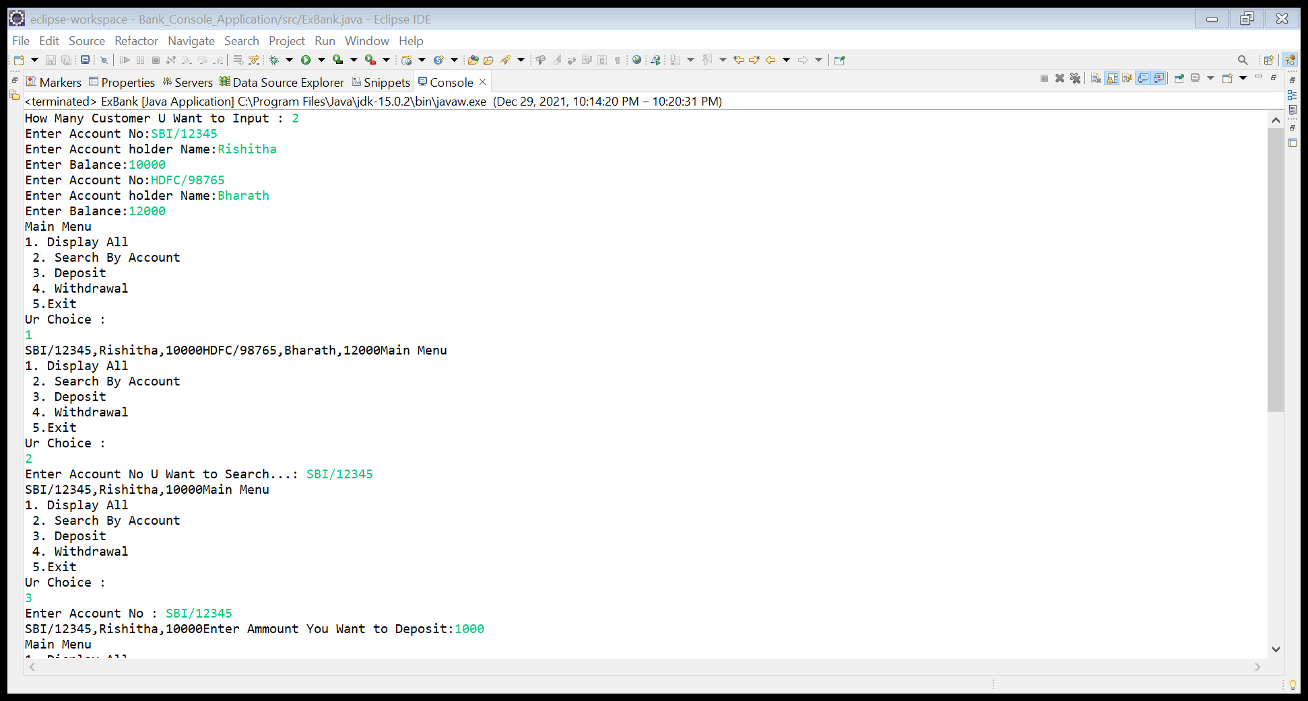

Slide 5
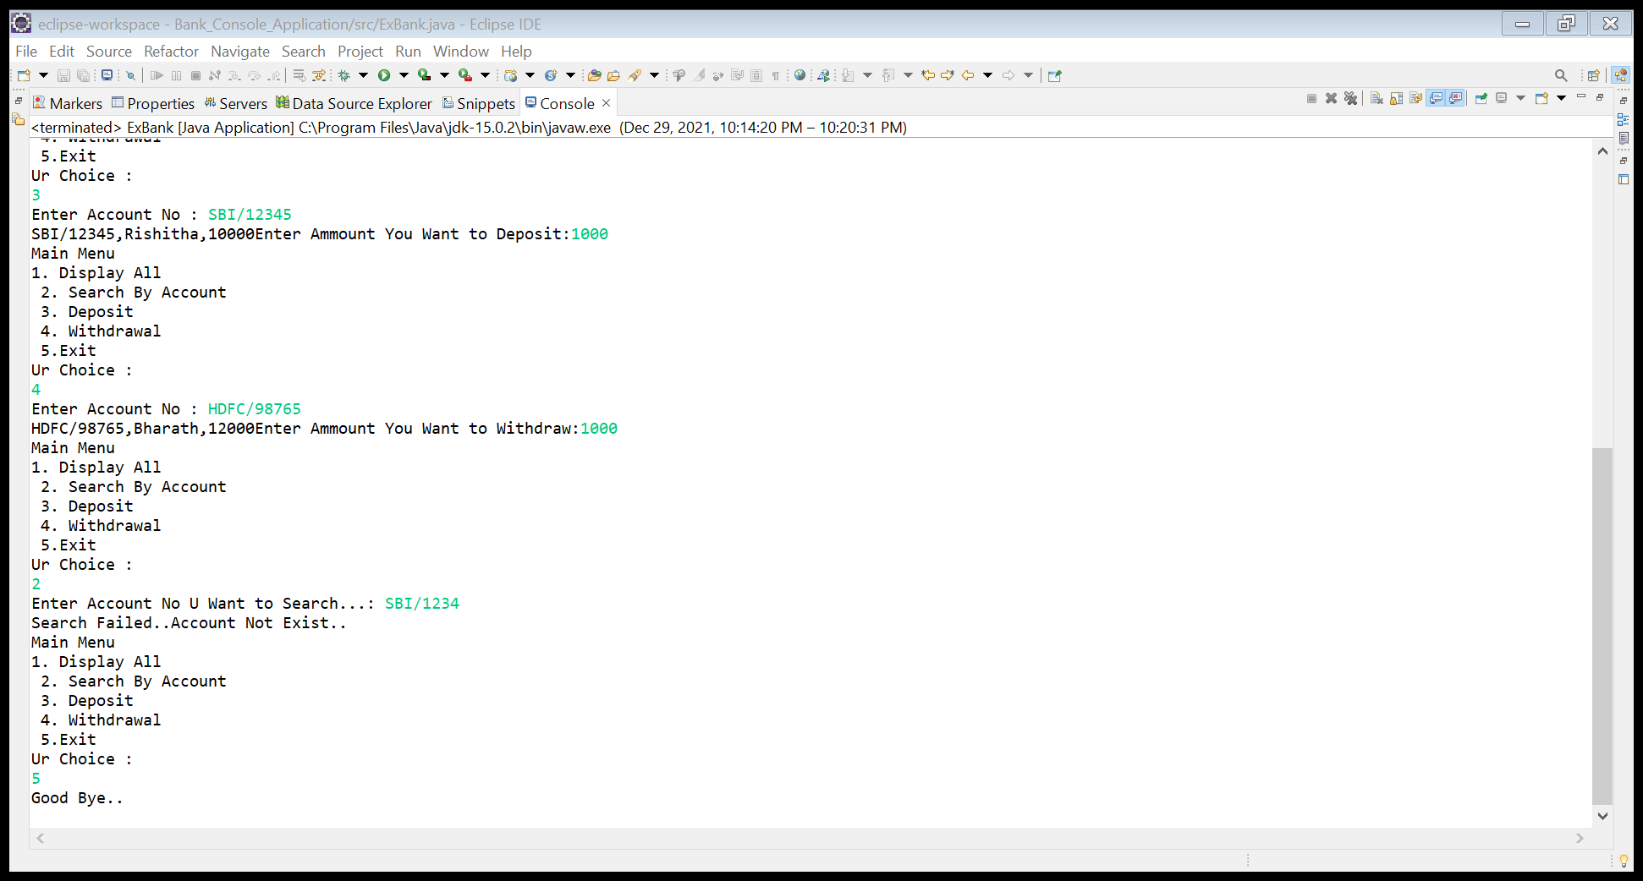

Slide 6
Thank You

